Slide 1



Machine Learning Regression Project
BIKE SHARING SYSTEMS
TEAM – 9
Malyala Greeshmajha
Sherolla Bhavana
J.Prakash Swain
Gagan Raj
Bhavan’s Vivekananda College | B.Sc. Hons Data Science
01

Slide 2

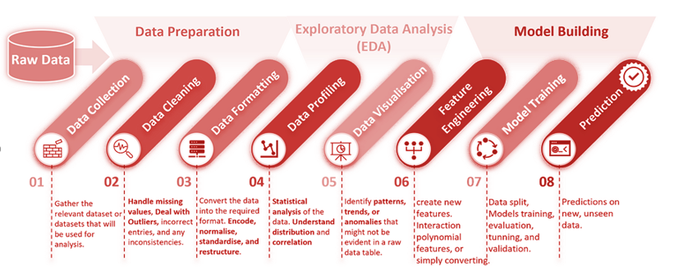
Machine Learning Project Workflow
Each of these steps plays a vital role in creating an effective ML model. The tasks require careful thought, good methodology, and often, a lot of iteration and fine-tuning.
02

Slide 3

1. Introduction to Data &
Defining Objective.
2. Dataset Overview.
3. Data Pre-processing.
Exploratory Data Analysis (EDA).
5. Model Building.
6. Comparative Model
Evaluation.
7. Conclusion &
Recommendations.
8. Appendix.
AGENDA
OVERVIEW
03

Slide 4

The data set was obtained from the Capital Bike Share program in Washington, D.C. which contained the historical bike usage pattern with weather data spanning two years.
Objective :
Currently, Rental bikes are introduced in many urban cities to enhance mobility comfort. It is important to make the rental bike available and accessible to the public at the right time as it lessens the waiting time.
Hence, the objective here is to build a superior statistical model to predict the number of bicycles required at each hour that can be rented with data availability.
Technical Approach :
We are implementing multiple machine learning models to fit the best model for the dataset.
Data Background :
04

Slide 5
DATA INTEGRITY ASSESSMENT
Data Introduction :
This dataset consists of the hourly count of rental bikes with 17 columns and 17379 instances (rows) between the years 2011 and 2012 in the Capital bike share system with the corresponding weather and seasonal information.
Variables :
Variable Name | Description | Type
dteday | date | Numerical – Discrete
season | season (1:winter, 2:spring, 3:summer, 4:fall) | Categorical - Nominal
yr | year (0: 2011, 1:2012) | Categorical - Nominal
mnth | month ( 1 to 12) | Categorical – Nominal
05

Slide 6
hr | hour (0 to 23) | Numerical - Discrete
holiday | whether the day is a holiday or not (0 & 1). | Categorical - Nominal
weekday | day of the week (0 to 6). | Categorical – Nominal
workingday | if a day is neither a weekend nor a holiday is 1, otherwise is 0. | Categorical - Nominal
weathersit | 1: Clear, Few clouds, Partly cloudy, Partly cloudy 2: Mist + Cloudy, Mist + Broken clouds, Mist + Few clouds, Mist 3: Light Snow, Light Rain + Thunderstorm + Scattered clouds, Light Rain + Scattered clouds 4: Heavy Rain + Ice Pallets + Thunderstorm + Mist, Snow + Fog | Categorical - Nominal
06

Slide 7
temp | normalized temperature in Celsius | Numerical-Continuous
atemp | "feels like" temperature or apparent temperature in Celsius(only in hourly scale) | Numerical-Continuous
hum | Normalized humidity. The values are divided to 100 (max) | Numerical-Continuous
windspeed | Normalized wind speed. The values are divided to 67 (max) | Numerical-Continuous
casual | count of casual users or non-registered user rentals for the hour | Numerical-Continuous
registered | count of registered users for the hour | Numerical-Continuous
cnt (TARGET) | count of total rental bikes (casual + registered) | Numerical-Continuous
07

Slide 8
Data Pre-processing
08

Slide 9
Missing Values : There are no missing values.
2. Duplicate Values : There are no duplicate values.
Feature Engineering :
Binning- one of the popular feature engineering techniques, “binning”, can be used to normalize noisy data.
Here, we divide the range of values of numerical variables into a set of intervals or bins and then assign a categorical label to each bin, so that we can create plots/graphs.
4. Dropped Columns:
Dropping unnecessary columns
instant – It is just a sequence number of rows.
dteday – It is not required since columns for year and month already exist.
atemp – To reduce the dimensionality of the predictive model, the feature
“atemp” is dismissed.
weekday – We already have working day and weekend .
09

Slide 10
5. Dummy Variable Encoding :
In Dummy variable encoding , for each unique category in a categorical variable, dummy variables are created.
Each dummy variable takes the value 0 or 1, indicating the absence or presence of a particular category.
To conclude, 17 columns have been reduced to 13 columns, and then by performing dummy variable encoding increased from 13 to 27 columns.
10

Slide 11
Exploratory Data Analysis (EDA)
11

Slide 12

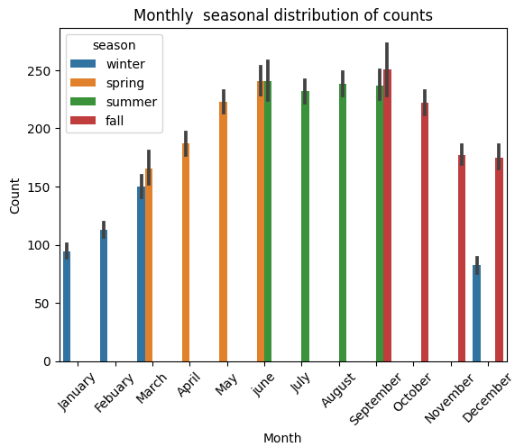
Multivariate Analysis :
The bar plot of month vs count with respect to season shows how people tend to use bikes in summer compared to other seasons.
12

Slide 13
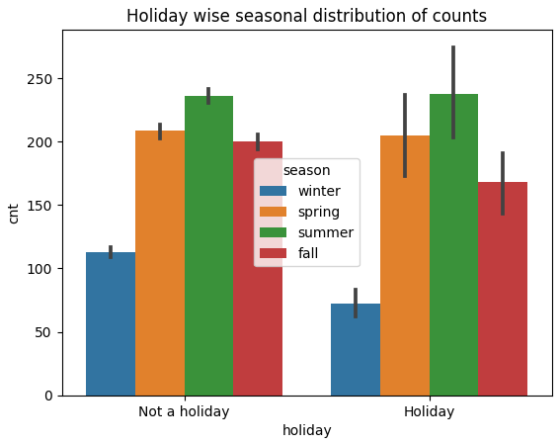
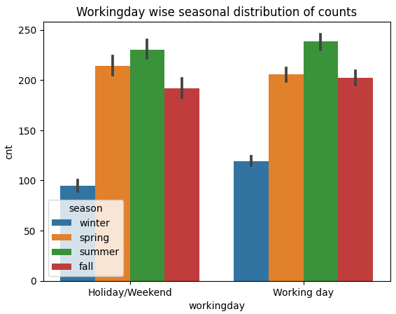
The working day and holiday seasonal distribution of count bar plots indicate that more bicycles are rented during normal working days than on weekends or holidays.
13

Slide 14
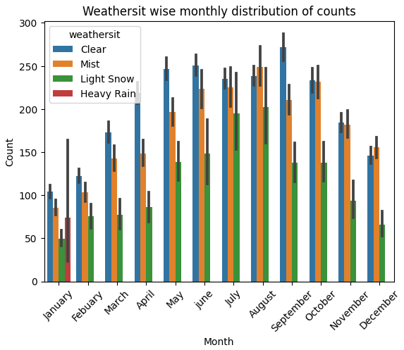
Bar plot of month vs count with respect to weather shows bike rentals are more during clear weather i.e., in the months of May to September.
14

Slide 15
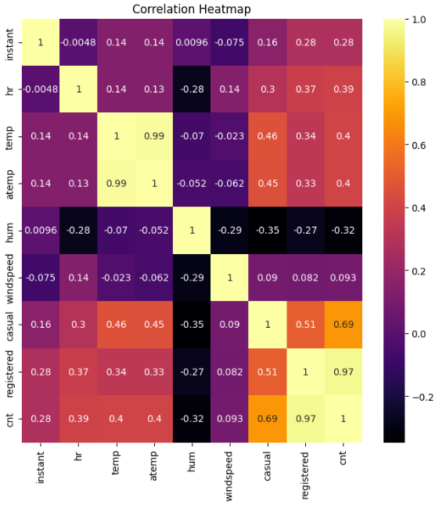
Heatmap Analysis
The correlation between 'temp' and 'cnt' indicates a moderate positive correlation. This suggests that as the temperature increases, bike rentals tend to go up.
The correlation between 'hum' and 'cnt' suggests a weak negative correlation. While not very strong, it indicates that higher humidity levels may have a slight negative impact on bike rentals.
The correlation between 'windspeed' and 'cnt' suggests a weak correlation. It implies that the lower wind speed leads to pleasant warmer weather and hence more bike rentals.
15

Slide 16
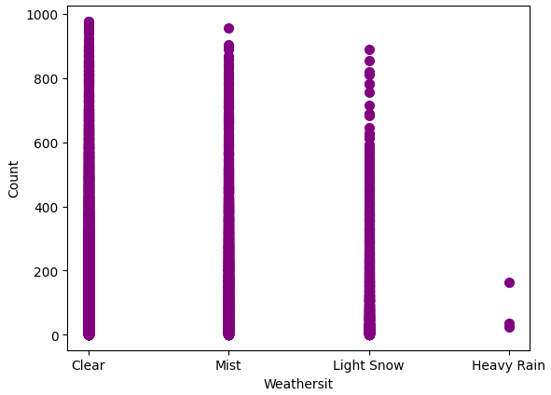
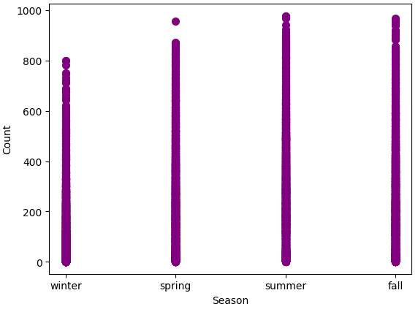
Bivariate Analysis:
Weather and season vs count scatter plots indicate people enjoy renting and riding bikes when the weather is clear and in the warm season(summer).
16

Slide 17
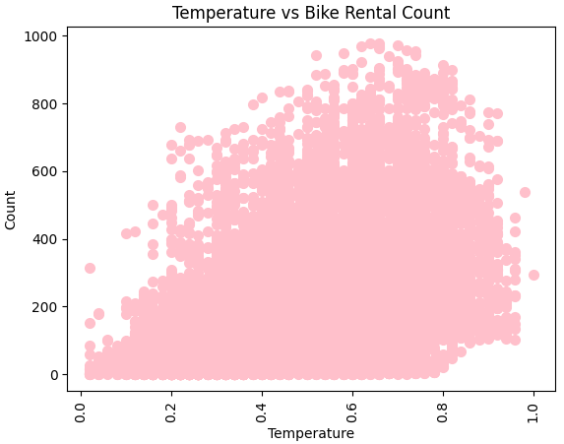
The scatter plot indicates bike rentals increase in warm weather. However, bike rentals decrease if the weather is too hot i.e., above 0.8, and lower temperatures decreases the average number of rents.
17

Slide 18
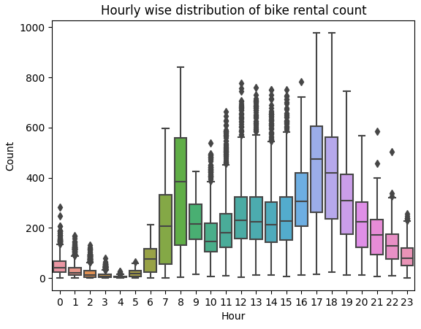
The hourly box plot show a maximum at 8 am and one at 5 -6 pm which indicates that most users of the bicycle rental service use the bikes to get to work or school. However, the number of bikes rented decreased in the evening due to cold weather.
18

Slide 19
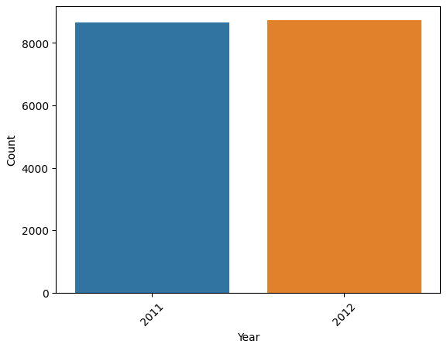
Univariate Analysis:
The count plot of yearly distribution indicates that the bike rentals in 2012 i.e., 8734 are more as compared to 2011 i.e., 8645.
19

Slide 20
Variance Inflation Factor – Multicollinearity Check
Variables | VIF
temp | 38.224
season_summer | 14.308
hum | 10.868
season_spring | 10.050
season_fall | 9.800
mnth_July | 9.118
mnth_August | 8.584
mnth_june | 6.951
mnth_May | 6.902
mnth_September | 6.678
mnth_October | 5.819
mnth_April | 5.780
mnth_November | 5.258
Multicollinearity occurs when two or more independent variables in a regression model are highly correlated, making it challenging to isolate the individual effect of each variable on the dependent variable.
A VIF above 5 indicates a high degree of multicollinearity.
20

Slide 21
Variables | VIF
workingday_Working day | 4.283
registered | 3.520
casual | 3.448
windspeed | 3.375
mnth_December | 3.370
mnth_March | 2.614
hr | 2.387
yr_2012 | 2.136
mnth_Febuary | 1.791
weathersit_Mist | 1.558
weathersit_Light Snow | 1.313
holiday_Holiday | 1.120
weathersit_Heavy Rain | 1.003
A VIF of 1 indicates no multicollinearity.
A VIF between 1 and 5 suggests moderate multicollinearity.
21

Slide 22
Decision-Making Frameworks (Algorithms)
1. Decision Tree
2. Linear Regression
3. Support Vector Machine
4. Random Forest
5. K Nearest Neighbors
6. Ada Boost
7. XG Boost
8. Gradient Boost
9. Neural Network
22

Slide 23
Decision Tree Regression :
Train-Test Ratio | R-sq. value | Mean Absolute Error(MAE)
65-35 | 0.999 | 2.405
70-30 | 0.999 | 2.220
75-25 | 0.999 | 2.194
80-20 | 0.999 | 2.165
23

Slide 24
2. Linear Regression :
Train-Test Ratio | R-sq. Value | Mean Absolute Error(MAE)
65-35 | 1.0 | 8.660e-14
70-30 | 1.0 | 2.648e-13
75-25 | 1.0 | 6.869e-14
80-20 | 1.0 | 4.692e-14
24

Slide 25
3. Support Vector Machine Regression :
Train-Test Ratio | R sq. Value | Mean Absolute Error(MAE)
65-35 | 0.999 | 0.077892
70-30 | 0.999 | 0.077782
75-25 | 0.999 | 0.077789
80-20 | 0.999 | 0.077964
25

Slide 26
4. Random Forest Regression :
Train-Test Ratio | R sq. Value | Mean Absolute Error(MAE)
65-35 | 0.999 | 0.979
70-30 | 0.999 | 0.923
75-25 | 0.999 | 0.908
80-20 | 0.999 | 0.883
26

Slide 27
5. K Nearest Neighbors Regression :
Train-Test Ratio | R sq. Value | Mean Absolute Error(MAE)
65-35 | 0.999 | 0.967
70-30 | 0.999 | 0.956
75-25 | 0.999 | 0.962
80-20 | 0.999 | 0.899
27

Slide 28
6. Adaptive Boost(Ada Boost) Regression :
Train-Test Ratio | n_estimators | R sq. Value | Mean Absolute Error (MAE)
65-35 | 15 | 0.97 | 20.82
 | 20 | 0.97 | 20.81
70-30 | 15 | 0.97 | 20.28
 | 20 | 0.97 | 20.87
75-25 | 15 | 0.97 | 20.80
 | 20 | 0.97 | 20.55
80-20 | 15 | 0.97 | 20.53
 | 20 | 0.98 | 19.73
28

Slide 29
7. Gradient Boost Regression :
Train-Test Ratio | n_estimators | Learning rate | R sq. Value | Mean Absolute Error(MAE)
65-35 | 1000 | 0.1 | 0.99 | 1.30
 |  | 0.05 | 0.99 | 1.50
 | 2000 | 0.1 | 0.99 | 0.96
 |  | 0.05 | 0.99 | 1.13
70-30 | 1000 | 0.1 | 0.99 | 1.30
 |  | 0.05 | 0.99 | 1.51
 | 2000 | 0.1 | 0.99 | 0.96
 |  | 0.05 | 0.99 | 1.16
29

Slide 30
Train-Test Ratio | n_estimators | Learning rate | R sq. Value | Mean Absolute Error(MAE)
75-25 | 1000 | 0.1 | 0.99 | 1.34
 |  | 0.05 | 0.99 | 1.56
 | 2000 | 0.1 | 0.99 | 0.97
 |  | 0.05 | 0.99 | 1.21
80-20 | 1000 | 0.1 | 0.99 | 1.31
 |  | 0.05 | 0.99 | 1.52
 | 2000 | 0.1 | 0.99 | 0.95
 |  | 0.05 | 0.99 | 1.13
30

Slide 31
8. Extreme Gradient (XG) Boost Regression :
Train-Test Ratio | n_estimators | Learning rate | R sq. Value | Mean Absolute Error(MAE)
65-35 | 1000 | 0.1 | 0.99 | 1.38
 |  | 0.05 | 0.99 | 1.40
 | 2000 | 0.1 | 0.99 | 1.36
 |  | 0.05 | 0.99 | 1.34
70-30 | 1000 | 0.1 | 0.99 | 1.38
 |  | 0.05 | 0.99 | 1.34
 | 2000 | 0.1 | 0.99 | 1.35
 |  | 0.05 | 0.99 | 1.28
31

Slide 32
Train-Test Ratio | n_estimators | Learning rate | R sq. Value | Mean Absolute Error(MAE)
75-25 | 1000 | 0.1 | 0.99 | 1.35
 |  | 0.05 | 0.99 | 1.40
 | 2000 | 0.1 | 0.99 | 1.33
 |  | 0.05 | 0.99 | 1.33
80-20 | 1000 | 0.1 | 0.99 | 1.30
 |  | 0.05 | 0.99 | 1.31
 | 2000 | 0.1 | 0.99 | 1.27
 |  | 0.05 | 0.99 | 1.25
32

Slide 33
9. Neural Network :
Train-Test Ratio | Architecture | Optimizer | Epochs | Mean Absolute Error(MAE)
65-35 | 64-32-1 | Adam | 50 | 0.019
 |  |  | 100 | 0.010
 | 27-20-1 | Adam | 50 | 0.476
 |  |  | 100 | 0.004
70-30 | 64-32-1 | Adam | 50 | 0.041
 |  |  | 100 | 0.007
 | 27-20-1 | Adam | 50 | 0.033
 |  |  | 100 | 0.012
33

Slide 34
Train-Test Ratio | Architecture | Optimizer | Epochs | Mean Absolute Error(MAE)
75-25 | 64-32-1 | Adam | 50 | 0.027
 |  |  | 100 | 0.230
 | 27-20-1 | Adam | 50 | 0.016
 |  |  | 100 | 0.044
80-20 | 64-32-1 | Adam | 50 | 0.002
 |  |  | 100 | 0.098
 | 27-20-1 | Adam | 50 | 0.015
 |  |  | 100 | 0.014
34

Slide 35
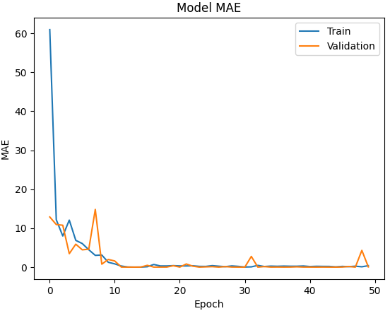
Train-Test Ratio | 80-20
Architecture | 64-32-1
Optimizer | Adam
Epochs | 50
Mean Absolute Error (MAE) | 0.002
35

Slide 36
Comparative Model Evaluation :
Model | MAE (80-20)
Decision Tree Regression | 2.165
Linear Regression | 4.692e-14
Support vector Machine Regression | 0.077782
Random Forest Regression | 0.883
K Nearest Neighbors Regression | 0.899
Ada Boost Regression | 19.73
XG Boost Regression | 1.25
Gradient Boost Regression | 0.95
Neural Network | 0.002
36

Slide 37
Conclusion :
After conducting a thorough analysis and implementing various ML algorithms, our efforts led us to discover that the Linear Regression algorithm gave the best results. In the context of an 80-20 train-test ratio, this model achieved a Mean Absolute Error (MAE) of 4.692e-14 which is the least error value among all the other errors.
Additionally, the R square value of 1 suggests that the model perfectly predicts the dependent variable i.e., predicted values match the actual values exactly.
Thus, we may deduce that, within the context of the provided bike-sharing dataset, the Linear Regression Algorithm stands out as the best possible model.
37

Slide 38
Recommendations :
Keeping the inferences in mind, we could suggest the following recommendations :
Most of the rentals are for commuting to workplaces and colleges on a daily basis. Hence, there is a need to launch more stations near these landmarks to reach out to their main customers.
While planning for extra bikes to stations the peak rental hours must be considered, i.e. 7–9 am and 5–6 pm.
Offer dynamic pricing depending upon the seasonal variations to promote bike usage during fall and winter seasons.
38

Slide 39
Maintenance activities for bikes should be done at night due to low usage of bikes during the night time. Removing some bikes from the streets at night time will not cause trouble for the customers.
Converting registered customers to casual customers by providing them with discounts and coupons.
The profitability of bike share systems can vary depending on factors such as user demand, operational costs, pricing strategies, and partnerships with local businesses. Careful planning and efficient management are crucial for long-term profitability.
39

Slide 40


Presented by:
Malyala Greeshmajha
Sherolla Bhavana
J.Prakash Swain
Gagan Raj
Colab Link:
https://colab.research.google.com/drive/1dvZsr9YRhBPHOpMEpwLhZQ8qvFYm51en?usp=sharing

Slide 41

Appendix

Slide 42
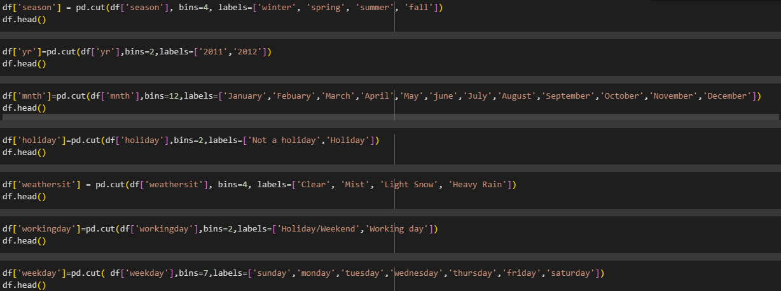
Feature Engineering - Binning

Slide 43
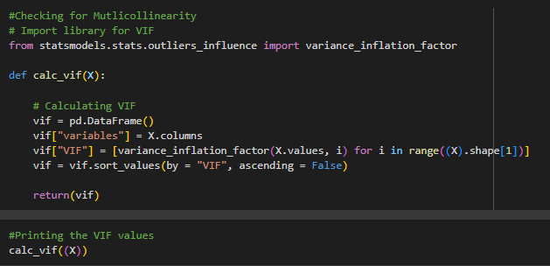
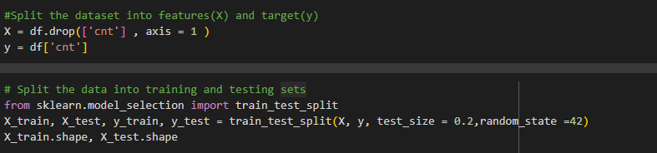
VIF- Mutlicollinearity Check
Train-Test Split Sets

Slide 44
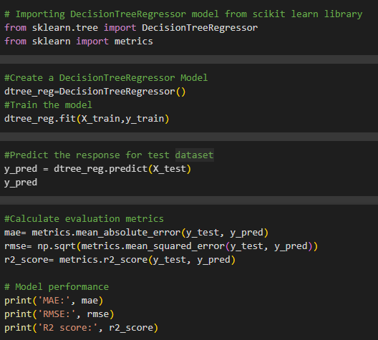
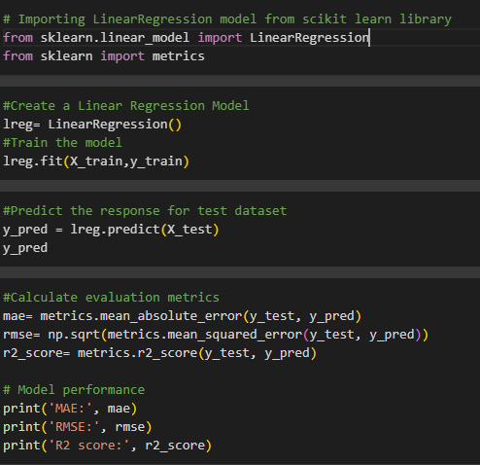
Decision Tree Regression
Linear Regression

Slide 45
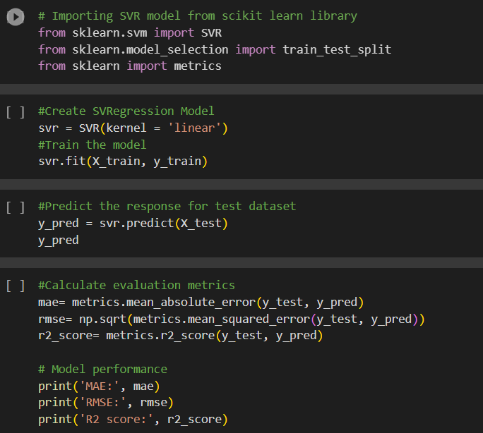
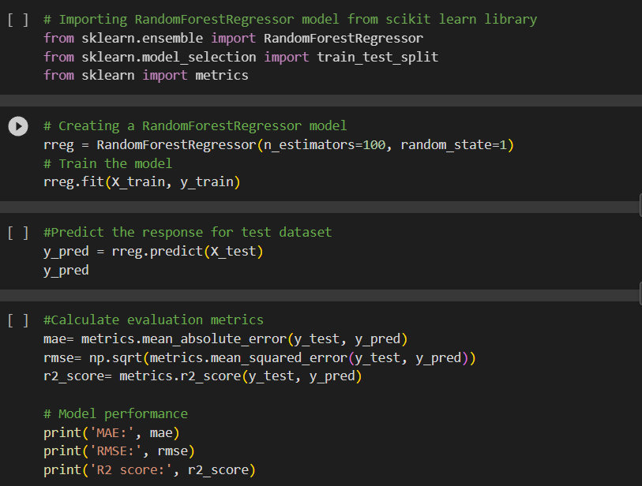
Support Vector Machine Regression
Random Forest Regression

Slide 46
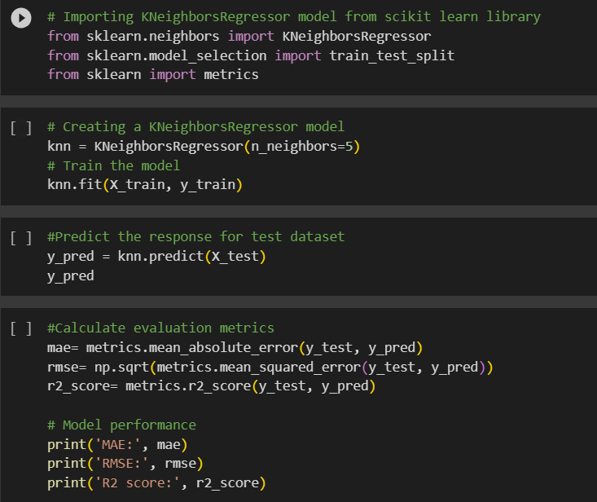
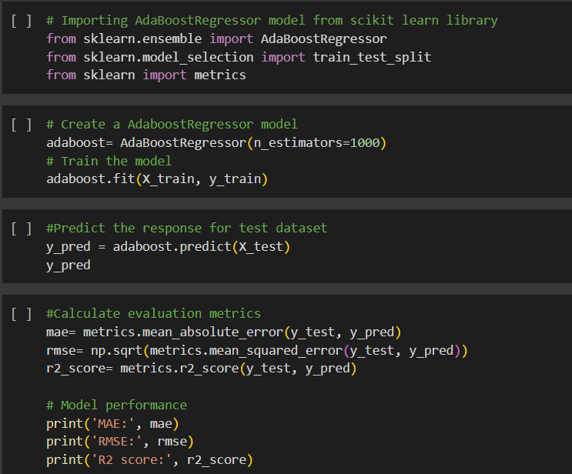
K Nearest Neighbors Regression
Ada Boost Regression

Slide 47
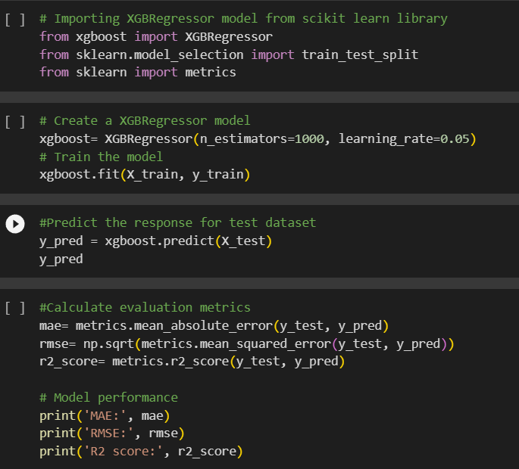
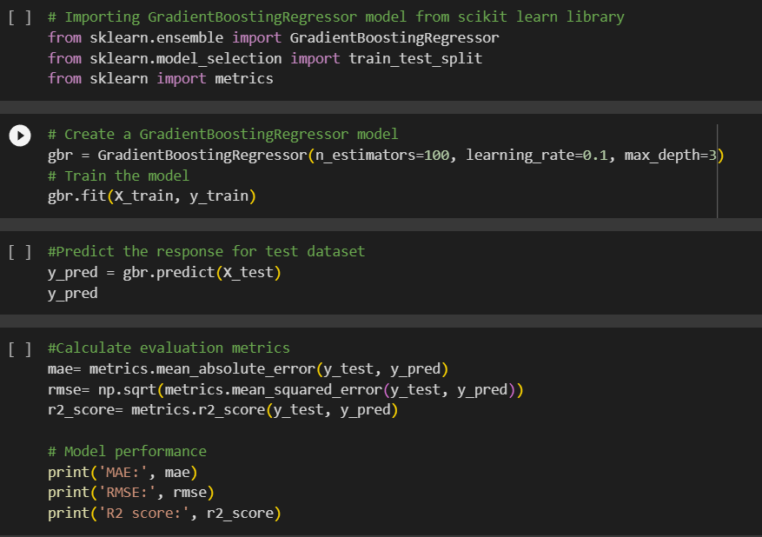
XG Boost Regression
Gradient Boosting Regression

Slide 48
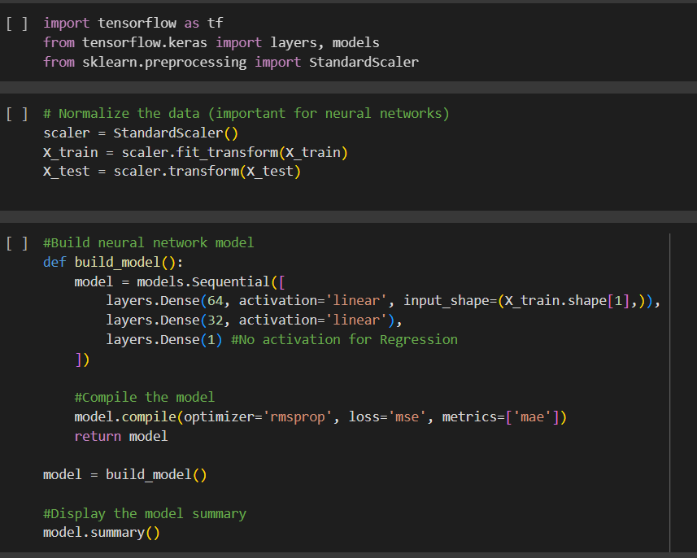
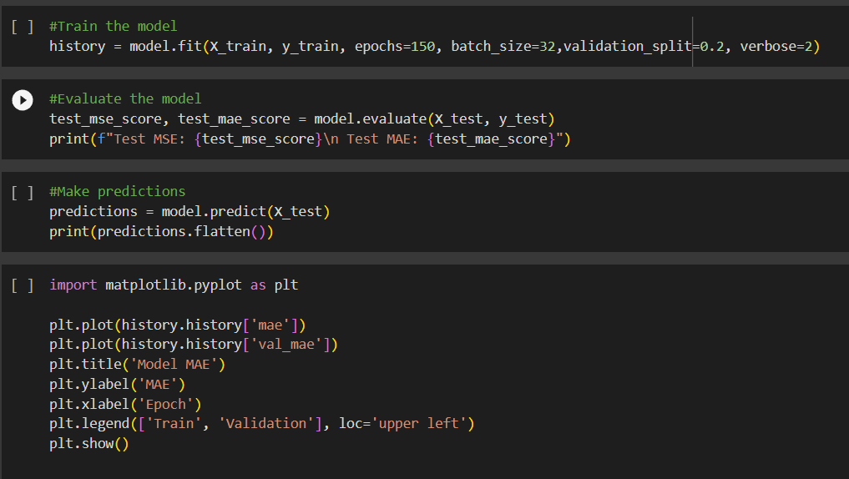
Neural Network

